Slide 1
CSE 11 Accelerated Intro to Programming Lecture 3
Greg Miranda, Spring 2021
This lecture is being recorded

Slide 2
Announcements
Quiz 3 due Monday @ 8am
Survey 1 due tonight @ 11:59pm
PA1 due Wednesday @ 11:59pm

Slide 3






Program Steps
class Example {
int x = 3 + 2;
int y = this.x * 4;
}

Slide 4
Expressions
int x = 3 + 2;
3 + 2
Arithmetic expression
Binary operator expression
int y = this.x * 4;
this.x
Field access expression
this.x * 4
Arithmetic expression where the left-hand operand is a field access expression

Slide 5
Methods
New class – MethodExample
In programming, we often want to describe a computation once
Then reuse it on different numbers, or different values
Write once, use it over and over again
Example:
Take two numbers and add up their squares
int sos1 = 3 * 3 + 5 * 5;
int sos2 = 4 * 4 + 7 * 7;

Slide 6
Define a method to do the same thing
int sumSquares(int n, int m) {
return n * n + m * m;
}
Vocabulary:
Method definition
Parameters
Method body
return keyword

Slide 7
Running it…
Method definition doesn’t change what prints out or any of the fields
Run command – only prints out the values of the fields
Can use sumSquares() to do the calculation
int ans1 = this.sumSquares(3, 5);
int ans2 = this.sumSquares(4, 7);
Vocabulary:
Called the method
Arguments

Slide 8
Methods: one of the building blocks for building programs
Not just useful for arithmetic
Useful for many more things
Why do we care about methods?
Methods give us a centralized place to write a calculation
Change in one place, every place that uses the method will see that update
As program gets large:
Might have 100s of places where we want to use a formula or calculation
Update them all by changing one place
Methods are self documenting – with meaningful names

Slide 9









class MethodExample {
int sumSquares(int n, int m) {
return n * n + m * m;
}
int ans1 = this.sumSquares(3, 5);
int ans2 = this.sumSquares(4, 7);
}

Slide 10



Slide 11





class MethodExample {
int sumSquares(int n, int m) {
return n * n + m * m;
}
int ans1 = this.sumSquares(3, 5);
int ans2 = this.sumSquares(4, 7);
}

Slide 12
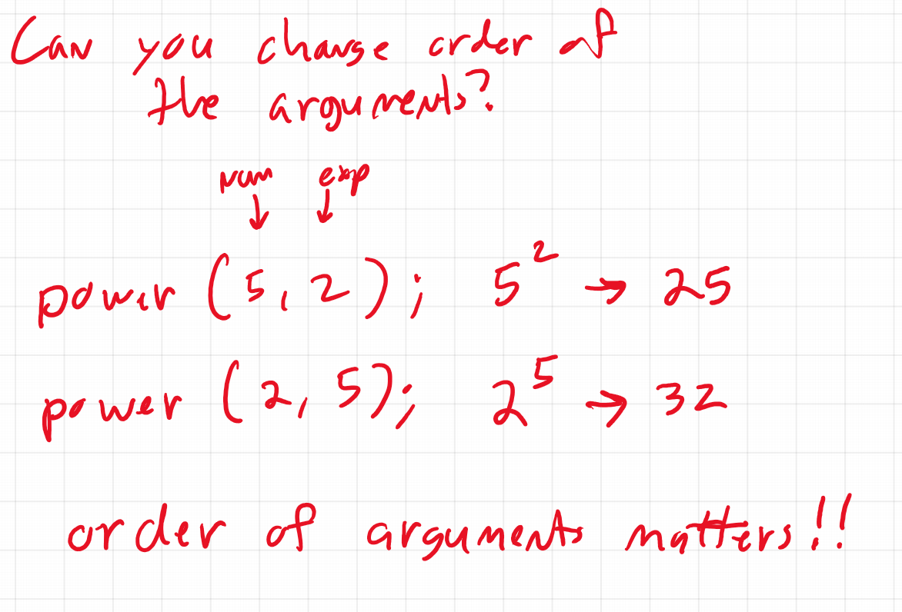

Slide 13
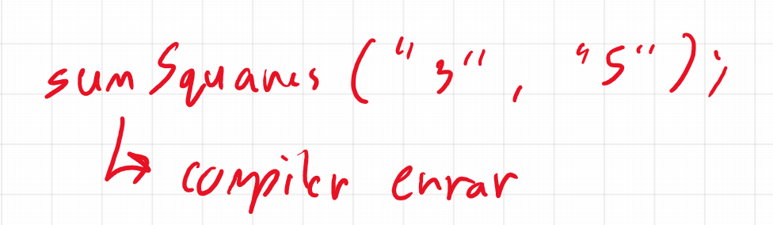

Slide 14
